Slide 1
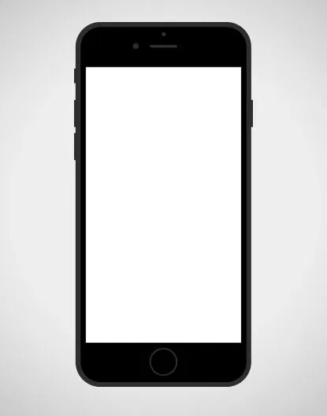
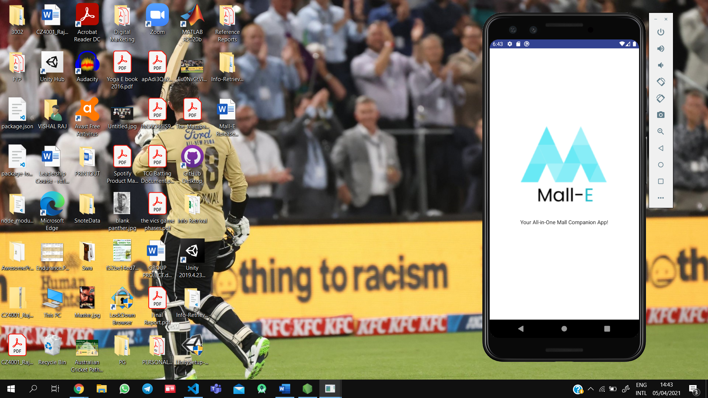
MALL-E
Your All-in-One Mall Companion App!
Developed by Run Time Error

Slide 2
OUR TEAM
Kelvin Chua Chong Hung
Melvin Chua Chong Hung
Das Atrik
U1823950C
U1921404D
U1921924G
Project Manager
Release Manager / Engineer
Front-End Developer / System Architect
Goh Hong Xiang, Bryan
Rajuravi Vishal Raj
Padhi Abhinandan
U1920609E
U1823860D
U182268B
Front-End Developer / Usability Analyst
Front-end/Back-end Developer
Quality Assurance Manager / Engineer

Slide 3
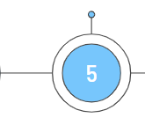
AGENDA
Project Introduction
Software Quality Assurance
Risk Management
Day 3
1
2
3
4
Software Version Control
Achievements
Design for Maintainability
Project Management
6
7
8
9
Issues Encountered
Live Demo

Slide 4
01
Project Introduction

Slide 5
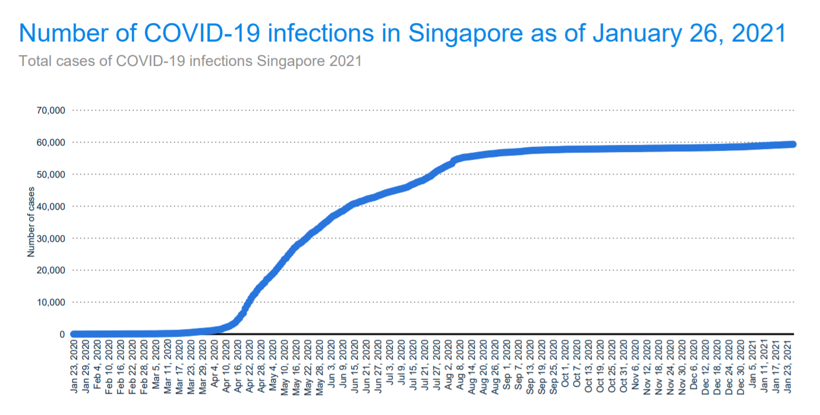
Understanding the Problem
COVID-19 infections in Singapore have plateaued since the start of Phase 3 in December, 2020
Citizens need to be cautious since the lockdown rules have been minified but the virus still remains
People are going out to malls and restaurants but they have to follow MOH’s safe-distancing-measures

Slide 6
OUR SOLUTION
01
02
03
Monitor
CROWD LEVELS
In malls around Singapore
Provides
WAITING TIME
In restaurants of chosen malls
Raise
AWARENESS
Of Covid-19

Slide 7
FUNCTIONAL REQUIREMENTS
01
Check Crowd Density of Malls
Map containing colored markers (based on crowd density) highlighting the malls
Graph of overall crowd density per hour scraped from Best Time API
02
Check Waiting/Queue Times of Restaurants
List of restaurants in that mall, each listing contains the name, cuisine, rating, location, description, and a picture of the restaurant
Data scraped from Google Popular Times API
03
Display News related to COVID in Malls in Singapore
Display the top 5 news articles from Google News related to COVID in Singapore malls
Each article has a headline, a picture, and the first 50 words of the article truncated

Slide 8



Tech Stack
React Native for the Frontend framework
NodeJS for the Backend framework
MongoDB for the Database

Slide 9
02
Design for Maintainability

Slide 10
Design Strategies
01
02
03
04
05
Planning Phase before Development
Process of Development
Correction by Nature
Enhancement by Nature
Maintainability Process

Slide 11
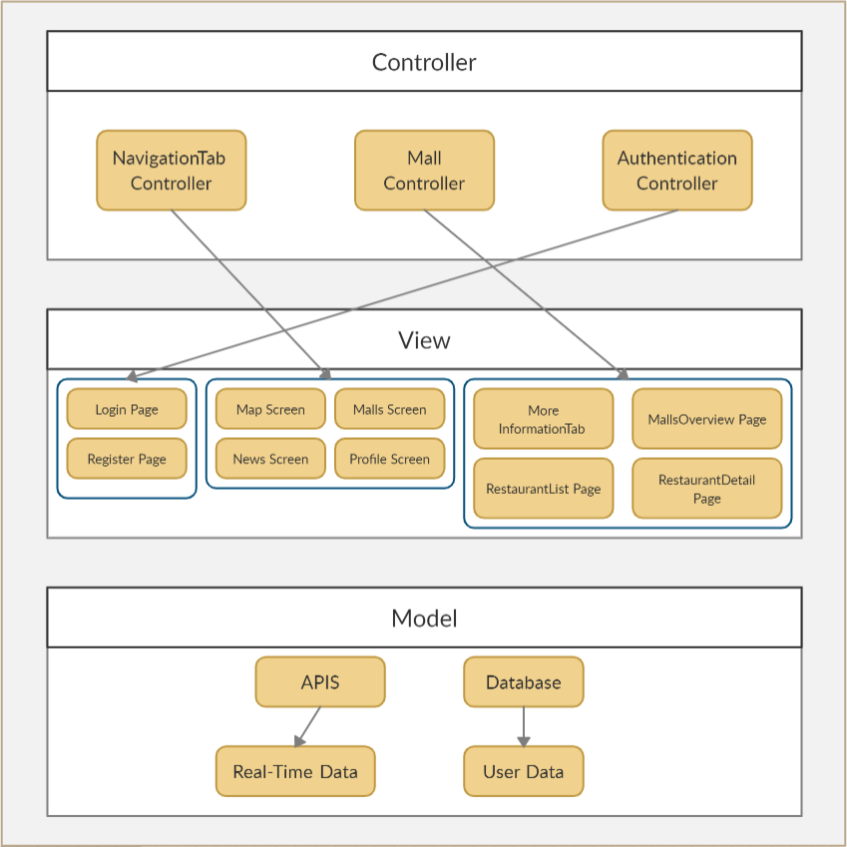
Architectural Diagram
To ensure Single Responsibility for easier maintainability.
Only one function needs to be changed / modified

Slide 12
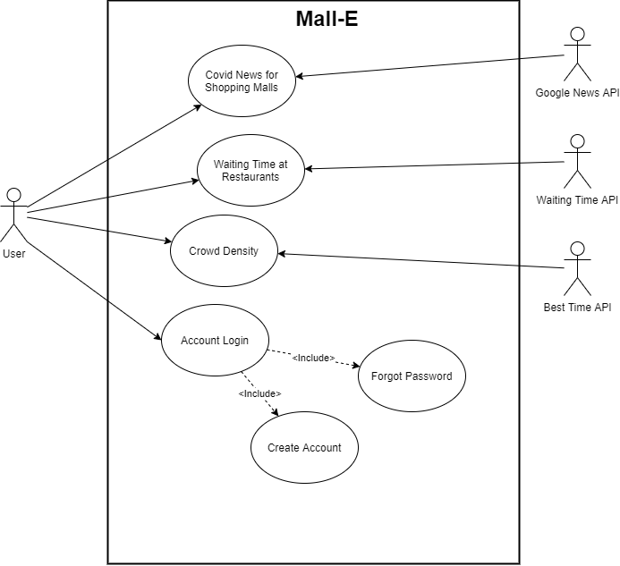
Use Case Diagram

Slide 13
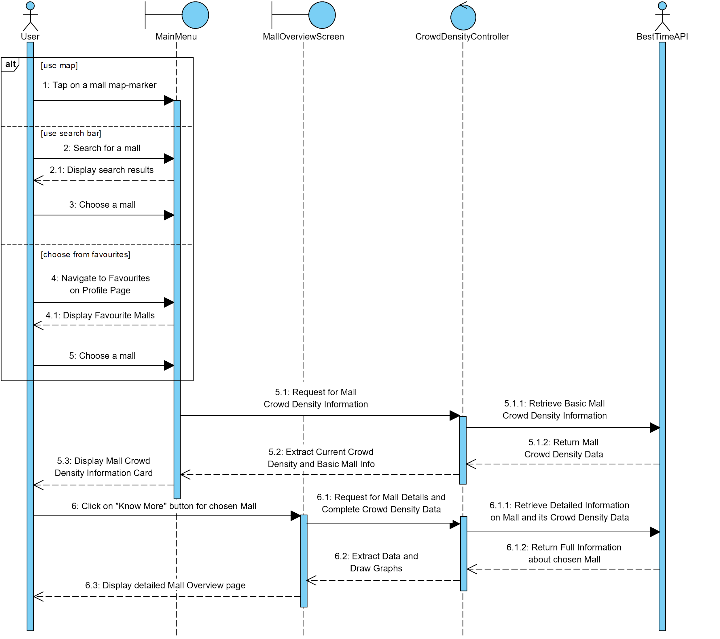
Crowd Density Sequence Diagram
Notes:
Crowd Density

Slide 14
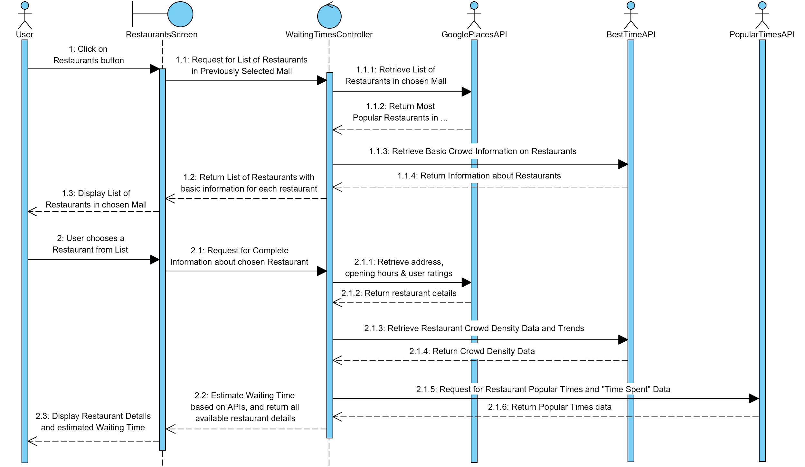
Waiting Time Sequence Diagram

Slide 15
03
Software Quality Assurance

Slide 16
Software Quality Programme
Quality Characteristics | Description
Functionality | Provide the 4 main functions; Login, Crowd Density, Waiting Time of restaurants, Covid News in Malls.
Usability | Offer Informative Feedback Reduce short-term memory load
Maintainability | Easy to maintain and update features
Portability | Compatible with iOS and Android Devices

Slide 17
Standard Metrics
01
02
03
04
05
Cyclomatic Complexity
Length of Identifiers
Fan-in/Fan-out
Depth of Conditional Nesting
Length of Code

Slide 18
04
Project Management

Slide 19
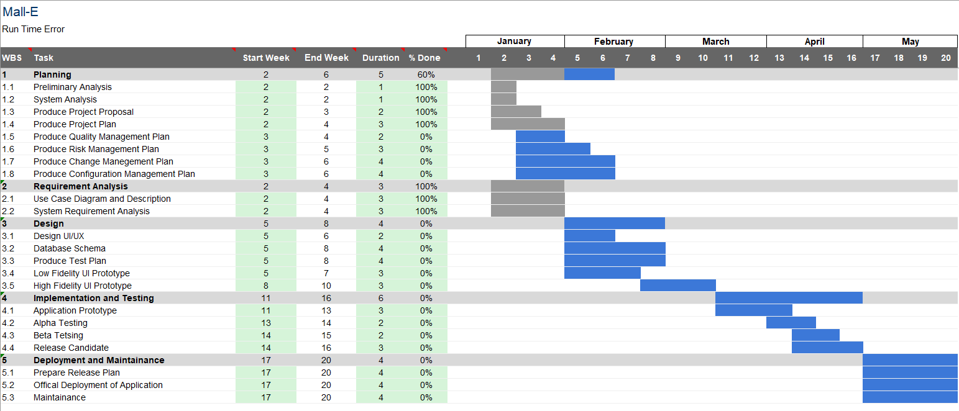
Project Timeline

Slide 20
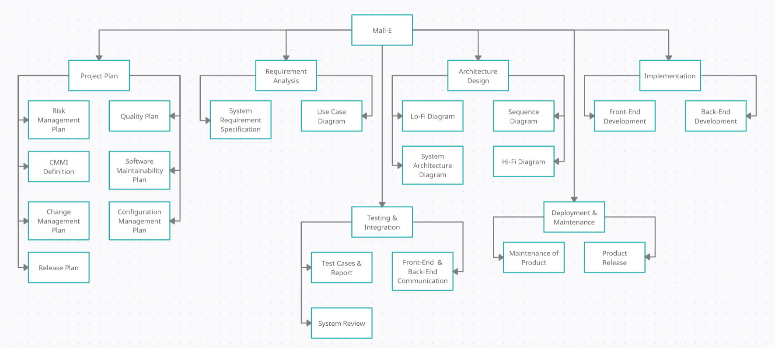
Work Breakdown Structure

Slide 21
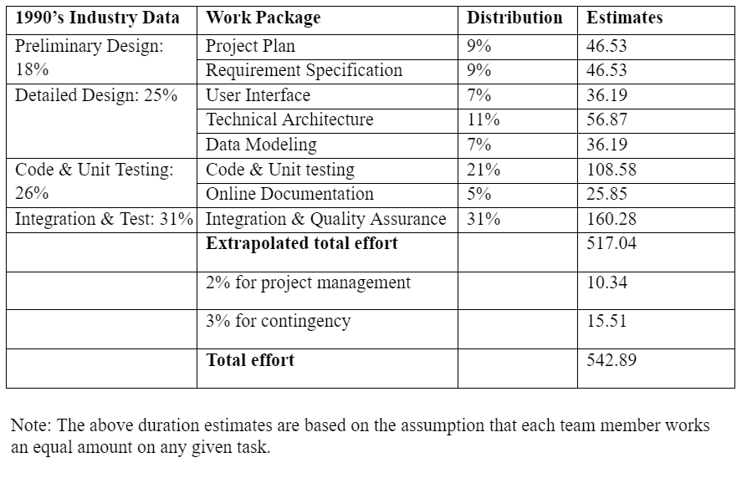
Distribution of Efforts

Slide 22
05
Risk Management

Slide 23
Risk Management Procedure
01
02
03
04
05
Process
Risk Identification
Risk Analysis
Quantitative Analysis
Qualitative Analysis
Risk Response Planning
Risk Monitoring, Controlling and Reporting

Slide 24
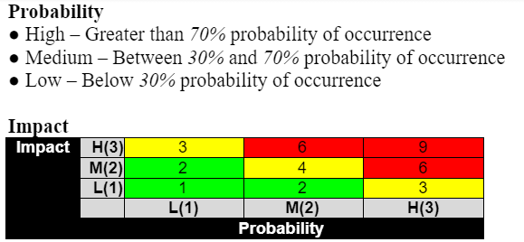
Risk Log (Top 5 Risks)
Risk Types | Risk Description | Occurrence | Impact | Qualitative Analysis
People | Poor Team coordination and team work within the team | Low | High | 3
Technology | Software development bugs | High | Medium | 6
Organisational | Unrealistic expectations by the senior management | High | High | 9
Requirements | Change in Functional Requirement and require major refactor of the software | Medium | High | 6
Estimation | The size of the Software is underestimated | Medium | Medium | 4

Slide 25
06
Software Version Control

Slide 26
Identification of configuration items
01
02
Mall-E.Vm.n
Mall-E : Project Name
V : Version
m.n.o : integer and version no.
Version Number m.n.o : Major.Minor.Patch
Major : Changes incompatible to previous version
Minor : New backward- functionalities are made
Patch : backward-functionalities bug fixes are made

Slide 27
ISSUES ENCOUNTERED
01
04
02
05
03
06
Retrieving data from BestTime API
React Native - Dependency Errors
Usage of non open source APIs
Integration of Python Backend & JavaScript Frontend
Google Maps API - Blank Maps
Merging Code

Slide 28
SOLUTIONS TO ISSUES
01
04
02
05
03
06
Used JavaScript Fetch Requests to retrieve Data (JSON files) from APIs.
Used Node Package Manager (NPM).
Contacted the API providers and got free student credits.
Used Python Flask server.
Made sure the app was connected to Google Maps API by a valid API key.
Used GitHub for Version Control.

Slide 29
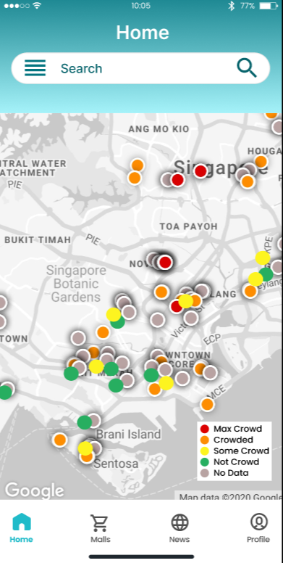
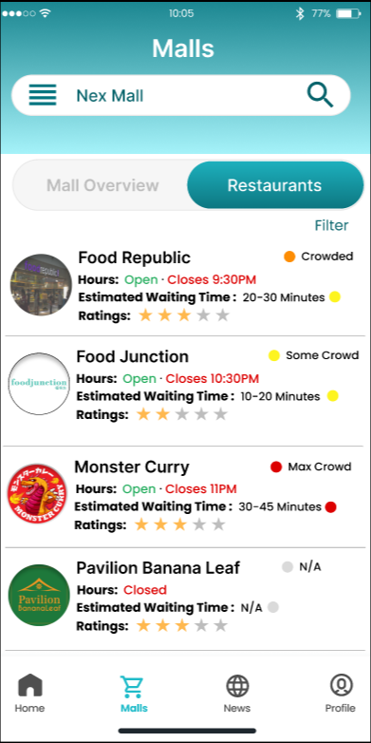
ACHIEVEMENTS
01
02
Meeting the expected UI standard
Usage of Real-Time Data

Slide 30
LIVE DEMO

